Slide 1
OpusCOMMS
Mid Year Seminar
Notes:
Hello, my name is Dannii, and I will talk to through the problem that my project is intended to solve and the solution I have begun implementing. I will also present a live preview of my solution so far.

Slide 2
Company Overview
Opus International Consultancy Ltd
Implement a new OpusCOMMS system
Communications and job-logging system
External and internal employees
Notes:
My project is for the company Opus international consultancy and this is an established company in 5 countries and employees over 3000 staff. They specialise in consultancy in many areas including buildings, transport and water.
The project that I am working on is known as OpusCOMMS, it is a communication site used for job logging and managing projects among both internal Opus staff and external contractors of Opus. Projects are broken down into tasks, which are assigned to employees to be completed. All this information needs to be managed and maintained.

Slide 3
Problem with existing OpusCOMMS
Different internal and external sites
Inflexibility across industries
Complaints
Low levels of user experience
Notes:
Currently, there is an OpusCOMMS system that is used to manage Opus projects. There is different site for internal Opus staff and external contractors. The system is not fit for use across all the different areas that Opus offers consultancy for. There have been complaints from the contractors who use the site. Both internal and external sites have low levels of user experience. Since the creation of the OpusComms site, all the software team that worked on the project have since left Opus, so the existing system has not been maintained over time.
During my time working on the project, there has been a strong emphasis on increasing user experience and making the system user friendly. To better understand the issues around user experience with the current system I had the privilege of being able to send a questionnaire to current users of the existing OpusCOMMS system to obtain their feedback. This feedback has enabled me to come up with some of the goals of a new system.

Slide 4
User Feedback
Goal: gain insights about the use of the current system and to identify areas to enhance user experience and usability.
My interest areas:
User’s purpose
Creation of information
Suggestions of features
Overall experience

Slide 5
Overall Experience
“It needs some work”
“It’s not user-friendly”
“Frustrating”
Would not “recommend its use”
“Not much better than a glorified spreadsheet”
“Does not meet our needs”
Notes:
As part of my questionnaire to existing users, the final question I asked them to describe their overall experience with the use of OpusCOMMS to gain an understanding about the enjoyment levels of the system. And here are some of the quotes taken from the answers of these questions.
So the overall experience with the system is negative. One person even said it was frustrating. So one of my goals, is I really want to turn these experiences around and ideally, if I was to ask the same question at the end of the project, I would want positive overall experiences.

Slide 6
Goals of the project
Incorporate user experience
Be user-friendly
Enable a simplistic, intuitive process
One site for internal and external users
Flexible across industries
Notes:
To summarise, the goals of my project, is a big emphasis on understanding user experience and creating a simplistic, intuitive process of use of the new system. I also need to create a site that is appropriate for both internal and external users, to bridge that gap of previous separation. This will make the system easier to maintain and more manageable. And the system must be flexible across all the different industries that Opus operates in, for example, applicable to both the transport industry and water industry.

Slide 7
Top Priority Tasks
Main functionality tasks
Creation of a database model
View all/your communications
Add a communication
Add an action against a communication
Log into the system
Notes:
My project goals have been split into high priority tasks and lower priority tasks. The high priority tasks are those that need to be completed to ensure the system completes the core functionality of what it required for the site.

Slide 8
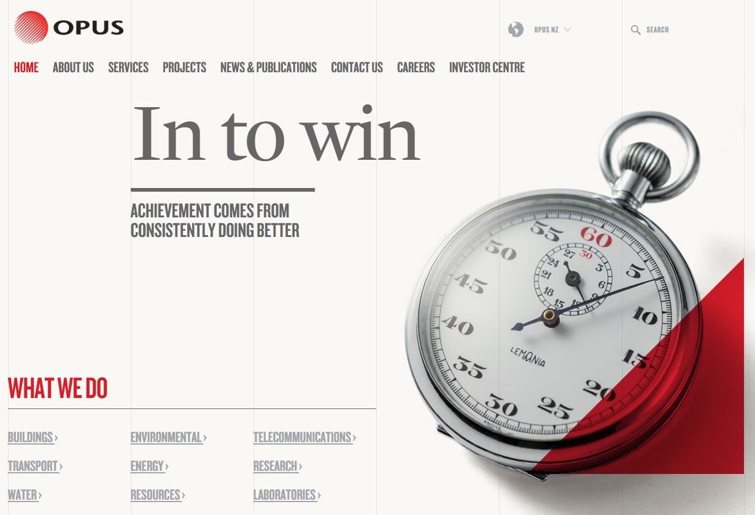
My Designs
Research into:
User-friendliness
What creates user experience
Usability
Opus’s current systems
Available online solutions

Slide 9
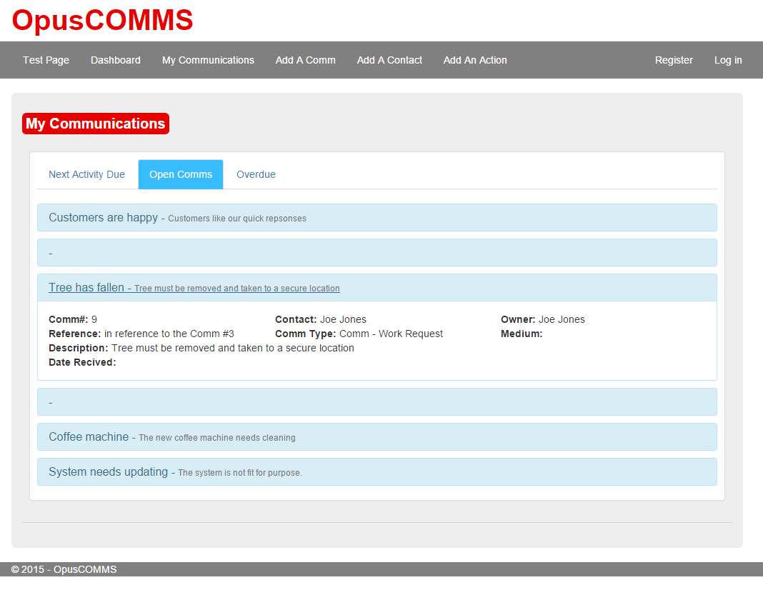
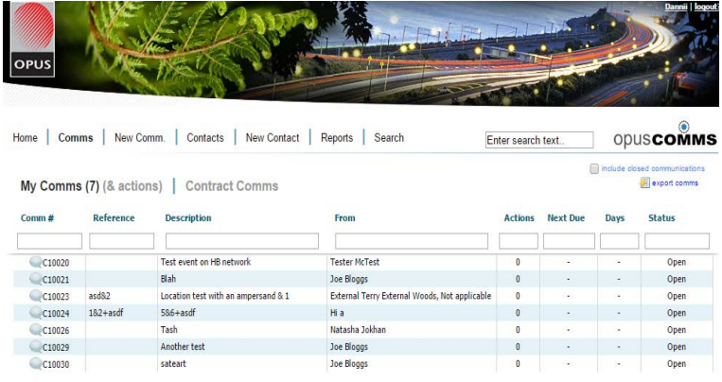
Designs
Notes:
The existing system is on the left, and my design of the site is on the right. I designed the page with the intention of incorporating some of the Opus brand, by using their colour scheme and using their website for inspiration. Their website embraces the use of a powerful red and compliments it with greys. The current system does not embrace the Opus brand, and I aimed to capture the Opus brand with my solution. Last week, during the holidays, I was emailed Opus’s brand booklet, which basically explains how their brand should be represented on websites and on paper, so I may reconsider some of the layouts I have used after going through the report in more detail. On this particular page, which on the existing site is the homepage, a user compared it to a spreadsheet and I felt it wasn’t very aesthetically pleasing or user friendly as all the information is displayed in a table, which can be overwhelming. So I wanted to stay away from this type of spreadsheet layout. In my layout, I have implemented progressive disclosure, which I will show you a live demo of shortly, so users can only have more information about the communication that they area interested in.

Slide 10
Live Demo
Notes:
So now I will take you through my site, and show you what I have implemented so far.
My solution represents the core functionality of the system. It is connected to a local database that I designed the structure for. Although, later in the year, I will be sent the real data to transfer this over to my database design.

Slide 11
Semester Two Plans
Add an action against a communication
Data validation
Log into the system
Contact management
Notes:
In terms of my plans for this semester, I need to continue implementing a few of the core functionality tasks. There was a couple of things I mentioned I would do as I went through the site. But these here are the main tasks, adding an action and data validation which are small tasks that I have begun implementing. As well as the ability to log into the system as a user.

Slide 12
Any Questions?
Thank you!

